Slide 1
Management oriented growth and yield models for eucalyptus
The GLOBULUS models

Slide 2
The GLOBULUS project
The GLOBULUS project started as a co-operative project between (ISA/DEF) and industry with three main objectives:
  to join all the growth data for eucalyptus available in Portugal in a common format
  using these data, to develop the “best” growth and yield model for eucalyptus plantations in Portugal applicable to the whole country, even if reparameterised for different regions
  to detect the need for additional data and trials

Slide 3
The GLOBULUS project
This model should be used for:
  operational planning at stand or company level
  strategic planning at country or regional level (long term wood availability)
  definition of forest policy measures
  definition and monitoring of sustainability criteria

Slide 4
DATA AVAILABLE
Biometric information system (sibFlor)
CFI of pulp
companies
POOL
OF
DATA
Editing
and
validation
Permanent
plots
sibFlor
Designed
trials
Celpa
Def
Portucel
Silvicaima
Soporcel
StoraCelbi

Slide 5
Model GLOBULUS 2
8 climatic regions defined on the basis of digitised climatic information
Compatible basal area initialisation and projection functions
Compatible total volume initialisation and projection functions

Slide 6
Model GLOBULUS 2
Additional output:
  total volumes over and underbark
  merchantable volumes
  total biomass
  biomass per components: wood, bark, leaves and branches
  leaf area estimation
  carbon sequestration
  nutrients accumulation

Slide 7
Definition of climatic regions
The climate of each one of the 275 counties in the country was characterised with the help of digitised climatic maps and a GIS
PCA followed by hierarchical classification were used to divide the country into 6 regions
South region was still split into 3 additional regions, originating a total of 8 regions

Slide 8
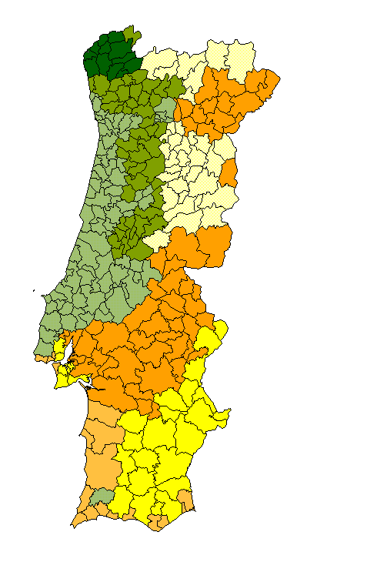
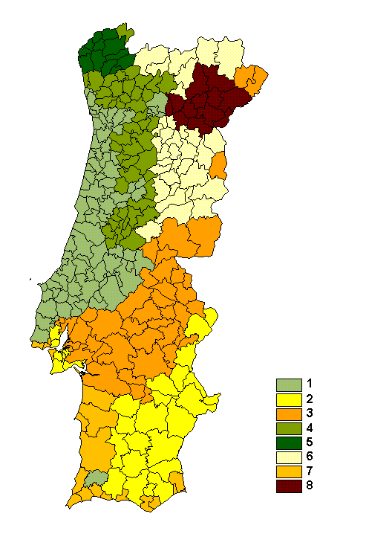
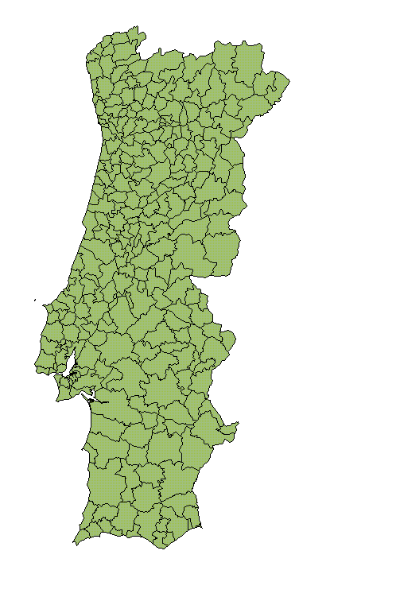
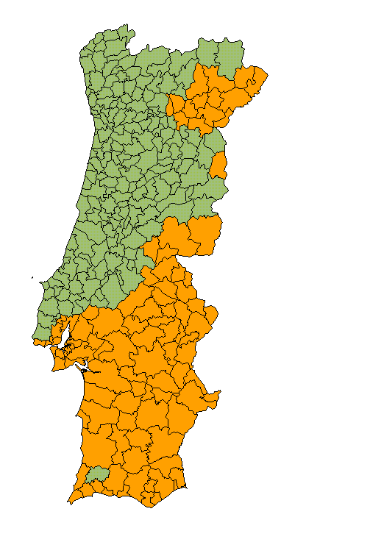
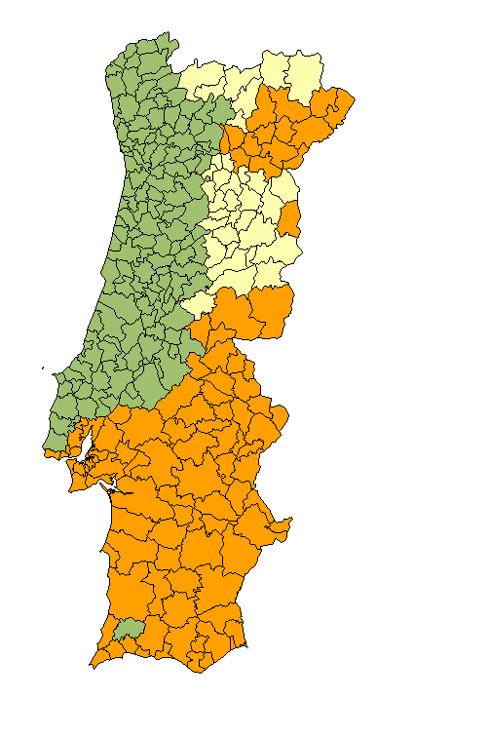
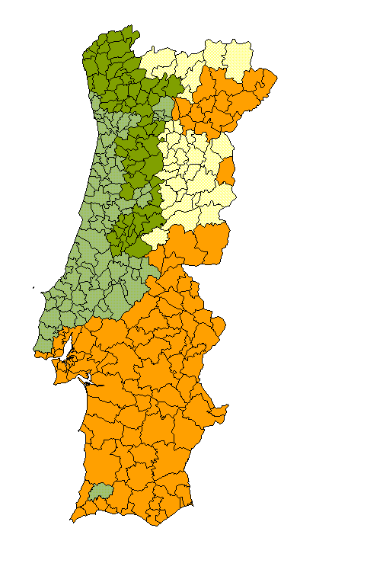
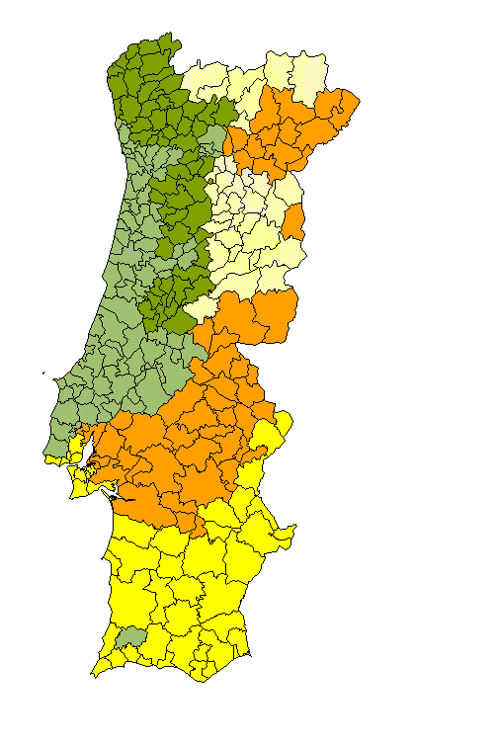

Hierarchical classification
Eight regions
1 North Litoral
2 North/centre Litoral
3 Centre Litoral
4 South Litoral
5 Tagus Valley
6 North Interior
7 South Interior
8 Douro valley

Slide 9
Caracterisation of the 8 regions
CLIMATE

Slide 10
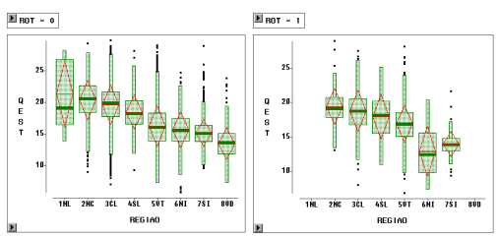
Caracterisation of the 8 regions
1st rotation
Coppiced stands
PRODUCTIVITY

Slide 11
Hierarchical dummy variables
1NL
reg4
reg3
2NC
reg2
3CL
6NI
reg1
4SL
reg6
7SI
reg5
5VT
reg7
8VD

Slide 12
MODEL STRUCTURE
Control variables:
  Climatic region (Reg)
  Site index (Si)
  Rotation (talh)
  Initial stand density (Npl if talh=0, N₀ if talh=1)
  Plant material (genetics)
  Silviculture

Slide 13
Initialisation functions
  hdom=f(t, Si, rot, Reg)
  N=f(t, Npl or N₀, Si, rot, Reg)
  G=f(t, Si, Reg, N, Fw₀)
  V_{ob}=f(t, Si, Npl or N₀, Fw₀, rot, Reg)
  V_{ib}=f(t, Si, Npl or N₀, Fw₀, rot, Reg)

Slide 14
State variables
  hdom₂=f(t₁, t₂, hdom₁, rot, Reg)
  N₂=f(t₁, t₂, N₁, Si, rot, Reg)
  G₂=f(t₁, t₂, G₁, N₁, N₂, Si, rot, Reg)
  V_{ob2}=f(t₁, t₂, V_{ob1})
  V_{ib2}=f(t₁, t₂, V_{ib1})

Slide 15
Derived variables
  V_{obdi}=f(V_{ob}, di, d_{m})
  V_{ibdi}=f(V_{ib}, di, d_{m})
  mai_{v} (ob and ib)
  cai_{v} (ob and ib)
  W_{t}=f(t, Si, G, N, hdom)

Slide 16
Derived variables (cont.)
  W_{stem}=f(t, Si, G, N, hdom, W_{t})
  W_{crowm}=f(W_{t}, W_{stem})
  W_{bark}=f(t, W_{stem})
  W_{wood}=f(W_{t}, W_{bark})
  W_{branch}=f(t, W_{stem})
  W_{leaf}=f(W_{t}, W_{bark})

Slide 17
Derived variables (cont.)
  Carbon=f(W_{wood}, W_{bark}, W_{leaf}, W_{branch} and chemical composition of each one of them)
  Nutrients= f(W_{wood}, W_{bark}, W_{leaf}, W_{branch} and nutrients content of each component)
  A mean chemical composition is assumed for all ages and sites

Slide 18
MODEL STRUCTURE
Control variables
Forest
Inventory
data
Initialization
functions
Values of
the derived
variables at ti+1
Initial values
for the state
variables at ti
Projection
equations
Values of
the state
variables at ti+1
i=i+1
Prediction
equations
N
S
end?
FIM
STOP

Slide 19
MODEL FORMS (1)
Dominant height growth
Site index estimation

Slide 20
MODEL FORMS (2)
Stand density initialisation and prediction
  prediction
  initialisation
  for 1st rotation and coppiced stands, respectively

Slide 21
MODEL FORMS (3)
Basal area initialisation and growth system (compatible)
  Growth function

Slide 22
MODEL FORMS (4)
Basal area initialisation and growth system (compatible)
  Initialisation

Slide 23
Total and merchantable volumes
Permanent plots
DATA
Eq.to predict
total and
merchantable
volumes
DATA
Harvested
trees
Total and
merchantable
volume ha⁻¹
Eq.to initialise and project
total volume and to predict
merchantable
volumes ha⁻¹

Slide 24
MODEL FORMS (5)
Total volume initialisation and growth system (compatible)
  Growth function
The same model forms were used for over and under bark volumes

Slide 25
MODEL FORMS (6)
Total volume initialisation and growth system (compatible)
  Initialization function

Slide 26
MODEL FORMS (7)
Merchantable volumes
(to top diameter d_{i})
The same model forms were used for over and under bark volumes

Slide 27
Total aboveground biomass and biomass per components
Permanent
plots
DATA
Eq. to predict
total biomass
and biomass
per componets
DATA
Biomass ha⁻¹
wood, bark,
branches and
leaves
harvested
trees
Eq. to predict
total biomass
and biomass
per components
ha⁻¹

Slide 28
MODEL FORMS (8)
Aboveground biomass system
  total biomass

Slide 29
MODEL FORMS (9)
Aboveground biomass system
  stem and crown

Slide 30
MODEL FORMS (10)
Aboveground biomass system
  bark and wood
  leaves and branches

Slide 31
Carbon and nutrients estimation
Stand
characteristics
model
inicialisation
CO2 nutrients
Biomass
Leaves
Leaves
Branches
Branches
Chemical composition
Wood
Wood
GLOBULUS
2.0
Bark
Bark
Biomass ha⁻¹
CO2 and nutrients ha⁻¹
Roots
Roots

Slide 32
GLOBULUS 2.1
Let’s see the EXCEL program that was prepared as a help for qualitative model evaluation

Slide 33
Globulus 3.0
Recently a new version of the Globulus model – Globulus 3.0 – was developed with a more diversified (in terms of planting density and site index) data set
Some of the problems that were detected in the GLOBULUS 2.1 were solved

Slide 34
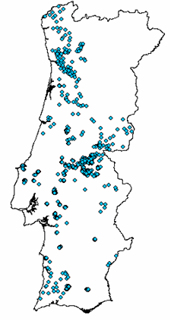
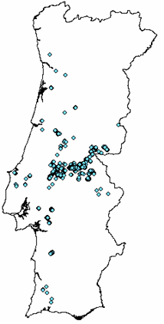
Globulus 3.0
Distribution of the data: stands from seedling (left) and coppice (right)

Slide 35
Globulus 3.0
Globulus 3.0 is not based in regions
Parameters of the growth and prediction equations are expressed as functions of climate variables (e.g., number of rainy days and altitude)
Globulus 3.0 considers the trasition between rotations, assuming a mortality rate for the stumps and including an equation to predict ingrowth of the new shoots

Slide 36
Globulus 3.0
The volume functions allow for a compatible estimation of volume with and without bark and with and without stump
Biomass functions were greatly improved

Slide 37
GLOBULUS 3.0
Read the word document that describes it!

